Slide 1
Expressions
Using a BNF to Capture precedence and associativity

Slide 2
Review
Parse trees
Ambiguity
Parse trees corresponding to lists
Left-recursive - grows towards the left
Right-recursive - grows towards the right
Algorithms for evaluating parse trees

Slide 3
A grammar for arithmetic expressions
Let M denote the set of all arithmetic expressions composed of integers and the addition and multiplication operators.
M = { 0, 1, … , 0 + 0, … }
Aside. How would one go about enumerating the elements of this set?
We are interested in constructing a grammar G such that L(G) = M.

Slide 4
Let G be a grammar containing the following rules.
E ::= E + E
| E ∗ E
| ( E )
| integer
integer ::= …
E ⇒* 7 | ✓
E ⇒* 6 + 7 | ✓
E ⇒* 6 ∗ 7 | ✓
E ⇒* 5 ∗ (6 + 7) | ✓
Claim. L(G) = M

Slide 5
E ::= E + E
| E ∗ E
| ( E )
| integer
…
In addition to the fact that L(G) = M, G is also ambiguous.
Proof (by example). E ⇒* 5 ∗ 6 + 7
E
E
E
+
E
E
∗
E
∗
E
7
5
E
+
E
E
6
7
5
6
One of these parse trees is semantically more appropriate than the other.

Slide 6
Guiding semantic principles
Before a tree is evaluated, its subtrees must be evaluated.
The subtrees of a tree are evaluated from left-to-right.

Slide 7
observations
The ∗ operator has a higher precedence than the + operator.
We would like to construct a grammar where it takes more derivation steps to generate an expression involving the ∗ operator than it does to generate an expression involving the + operator.

Slide 8
expr ::= expr + term | term
term ::= term * factor | factor
factor ::= ( expr )
| integer
expr ::= term + expr | term
term ::= factor * term | factor
factor ::= ( expr )
| integer
Both grammars are acceptable.
This is because both the + and ∗ operators are associative.

Slide 9
Associativity
Subtraction is a left-associative operator.
1 − 2 − 3 = (1 − 2) − 3 = ~4
Exponentiation is a right-associative operator.
2³⁴ = 2⁽³⁴⁾
Notational systems will, in general, contain operators that are associative, left-associative, and right-associative.

Slide 10
Observation
The expression on the left-hand side of a binary infix left-associative operator should have a longer derivation sequence than the expression on its right-hand side.
The expression on the right-hand side of a binary infix right-associative operator should have a longer derivation sequence than the expression on its left-hand side.

Slide 11
Aside: Separators versus Binary operators
Java method call has the following form.
name ( expr₁, expr₂, … , expr_{n} )
Note that the actual parameters of the method call are a comma-separated list of expressions.
A sum has a similar structure.
expr₁ + expr₂ + … + expr_{n}
Structurally, a sum is a “+”-separated list of expressions.
More importantly, sums are list-like in nature.

Slide 12
Left recursive is left associative
expr ::= expr + integer | integer
expr
expr
+
3
expr
+
2
1

Slide 13
Right recursive is Right associative
expr ::= integer + expr | integer
expr
2
+
expr
3
+
expr
4

Slide 14
An algorithm for fully parenthesizing Expressions
Given a table defining the precedence and associativity of every operator.
Given an expression in which parenthesis are to be inserted.
We will develop an algorithm for inserting parenthesis into the expression.

Slide 15
example
2 ∗ 3 − 4 + 5 ^ 6 ^ 7 − 1
= 2 ∗ 3 − 4 + 5 ^ (6 ^ 7) − 1
= 2 ∗ 3 − 4 + (5 ^ (6 ^ 7)) − 1
= (2 ∗ 3) − 4 + (5 ^ (6 ^ 7)) − 1
= ((2 ∗ 3) − 4) + (5 ^ (6 ^ 7)) − 1
= (((2 ∗ 3) − 4) + (5 ^ (6 ^ 7))) − 1
= ((((2 ∗ 3) − 4) + (5 ^ (6 ^ 7))) − 1)

Slide 16
Initial Conditions for our Algorithm
Given a table defining the precedence and associativity of every operator. (Operators having the same precedence must also have the same associativity).
Given an expression in which parenthesis are to be inserted.

Slide 17
Process precedence levels in decreasing order (i.e., start with the highest precedence level).
If the precedence level being processed is left-associative.
Scan the expression from the left, searching for the first unprocessed occurrence of an operator belonging to this precedence level. Insert parenthesis appropriately.
Continue processing this precedence level until all operators belonging to this precedence level have been processed. Then move on to the next lower precedence level.
If the precedence level being processed is right-associative.
Scan the expression from the right, searching for the first unprocessed occurrence of an operator belonging to this precedence level. Insert parenthesis appropriately.
Continue processing this precedence level until all operators belonging to this precedence level have been processed. Then move on to the next lower precedence level.

Slide 18
Generality
The algorithm for inserting parenthesis into an expression is applicable to any set of operators provided all operators at a given precedence level have the same left/right associativity.
It is not uncommon for the precedence and associativity table of a programming language to contain more than 15 operators.
Assuming symbols can be distinguished any expression containing any number of operators can be parenthesized provided one is given the precedence and associativity table for the operators.

Slide 19
Constructing a Grammar from a Precedence and Associativity Table
Start with the lowest precedence level and work your way up.
Create an appropriate nonterminal symbol A for the precedence level.
If the precedence level is left-associative, the rule will be left-recursive.
A ::= A …
If the precedence level is right-associative, the rule will be right-recursive. A ::= … A
Create a rule of the form A ::= B where B is the nonterminal symbol for the next higher precedence level.

Slide 20
Operator | Precedence | Associativity | Nonterminal
+, − | 1 (low) | left | expr
^ | 2 (high) | right | term
expr ::= expr + term
| expr – term
| term
term ::= factor ^ term
| factor
factor ::= integer
| ( expr )

Slide 21
Create the parse tree for 2 + 3 + 4 ^ 5 ^ 6
Hint - the last semantic operation must be derived first.
expr
expr
+
term
expr
+
term
factor
^
term
term
factor
4
factor
^
term
factor
3
5
factor
2
6

Slide 22
Guidelines for constructing Parse trees
Let e denote an expression containing n binary operators.
Let op₁, op₂, … , op_{n−1}, op_{n} denote the order in which operator calculations are performed when evaluating e using an inside-out, left-to-right evaluation scheme.
A parse tree corresponding to e can be created by deriving the operators in the following order.
op_{n}, op_{n−1}, … , op₂, op₁

Slide 23
3
2
1
4
Create the parse tree for 2 + 3 ^ 4 ^ 5 + 6
expr
expr
+
term
expr
+
term
factor
term
factor
^
term
6
factor
3
factor
^
term
2
4
factor
5

Slide 24
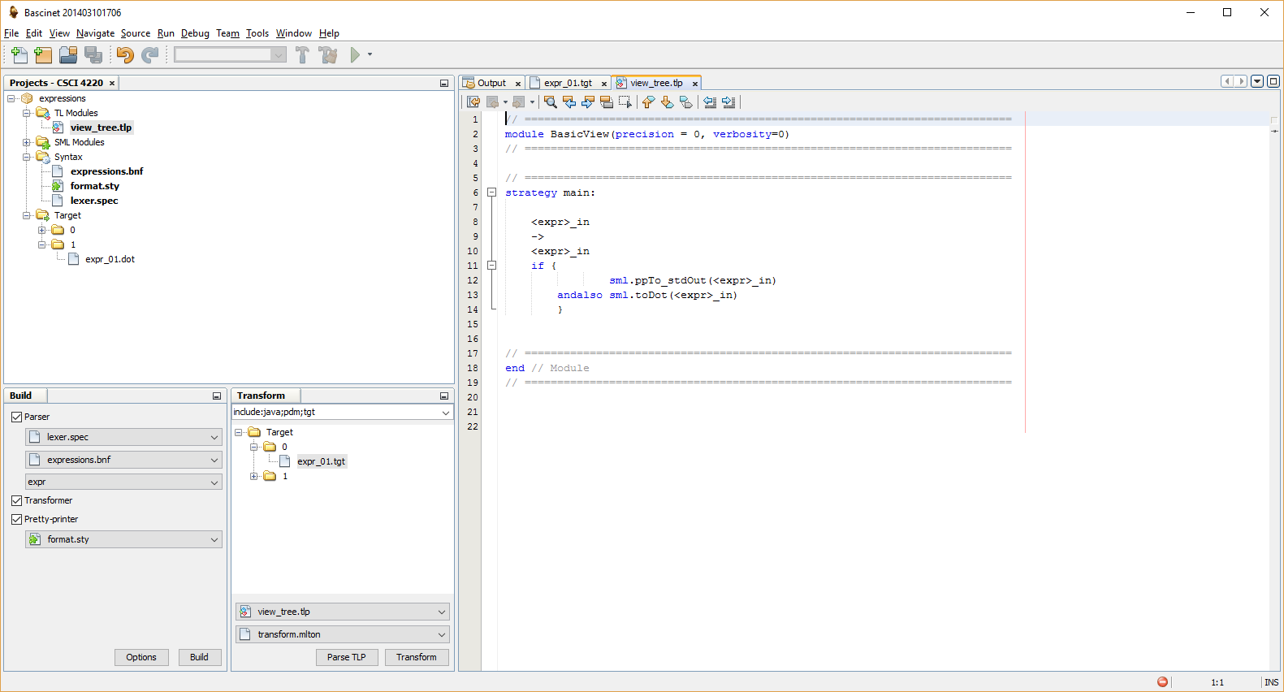

Slide 25
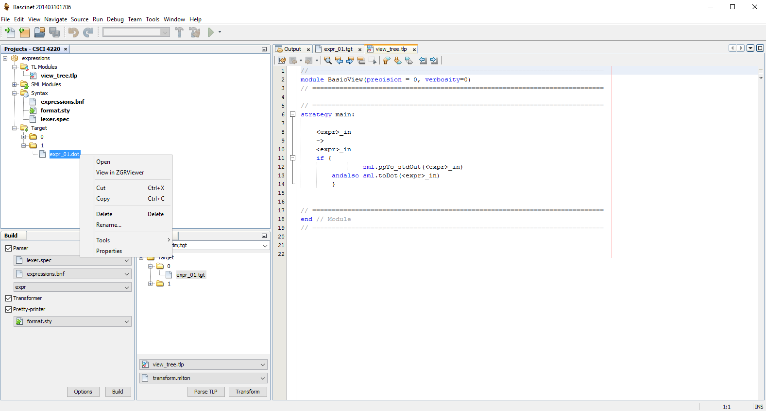

Slide 26
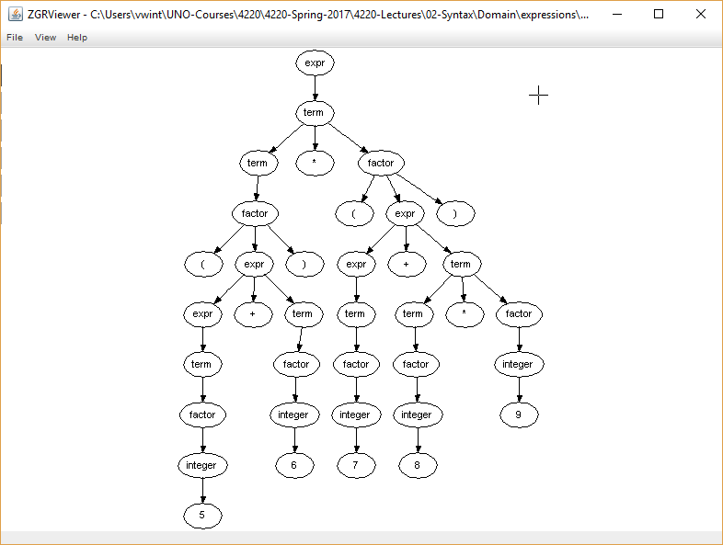

Slide 27
Abstract syntax trees (AST)
Parse trees can be large. However, they can be automatically created by a parser.
After parsing, trees are typically translated into a compact internal form called an abstract syntax tree (AST).

Slide 28
AST Example
2 + 3 ^ 4 ^ 5 + 6
+
plus(
plus(2,
pow(3,
pow(4,5)
)
),
6
)
+
6
2
^
3
^
4
5

Slide 29
(5 + 6) ∗ (7 + 8 ∗ 9)
∗
+
+
5
6
7
∗
8
9
times( plus(5,6), plus(7,times(8,9)) )

Slide 30
The End

